Slide 1

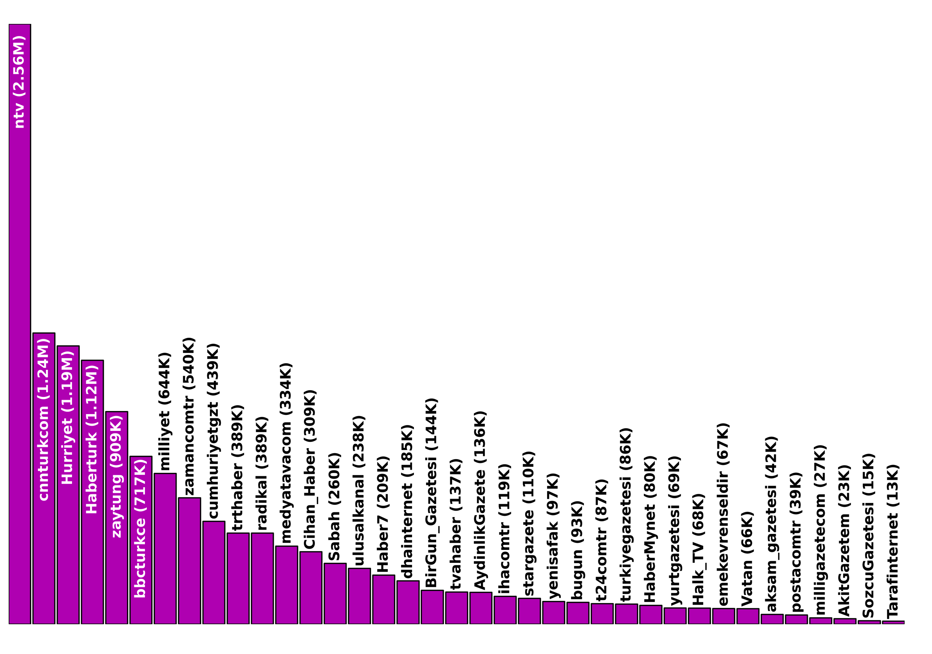
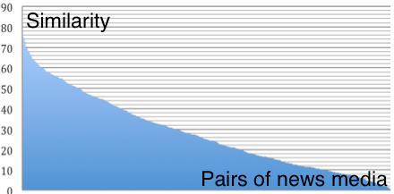
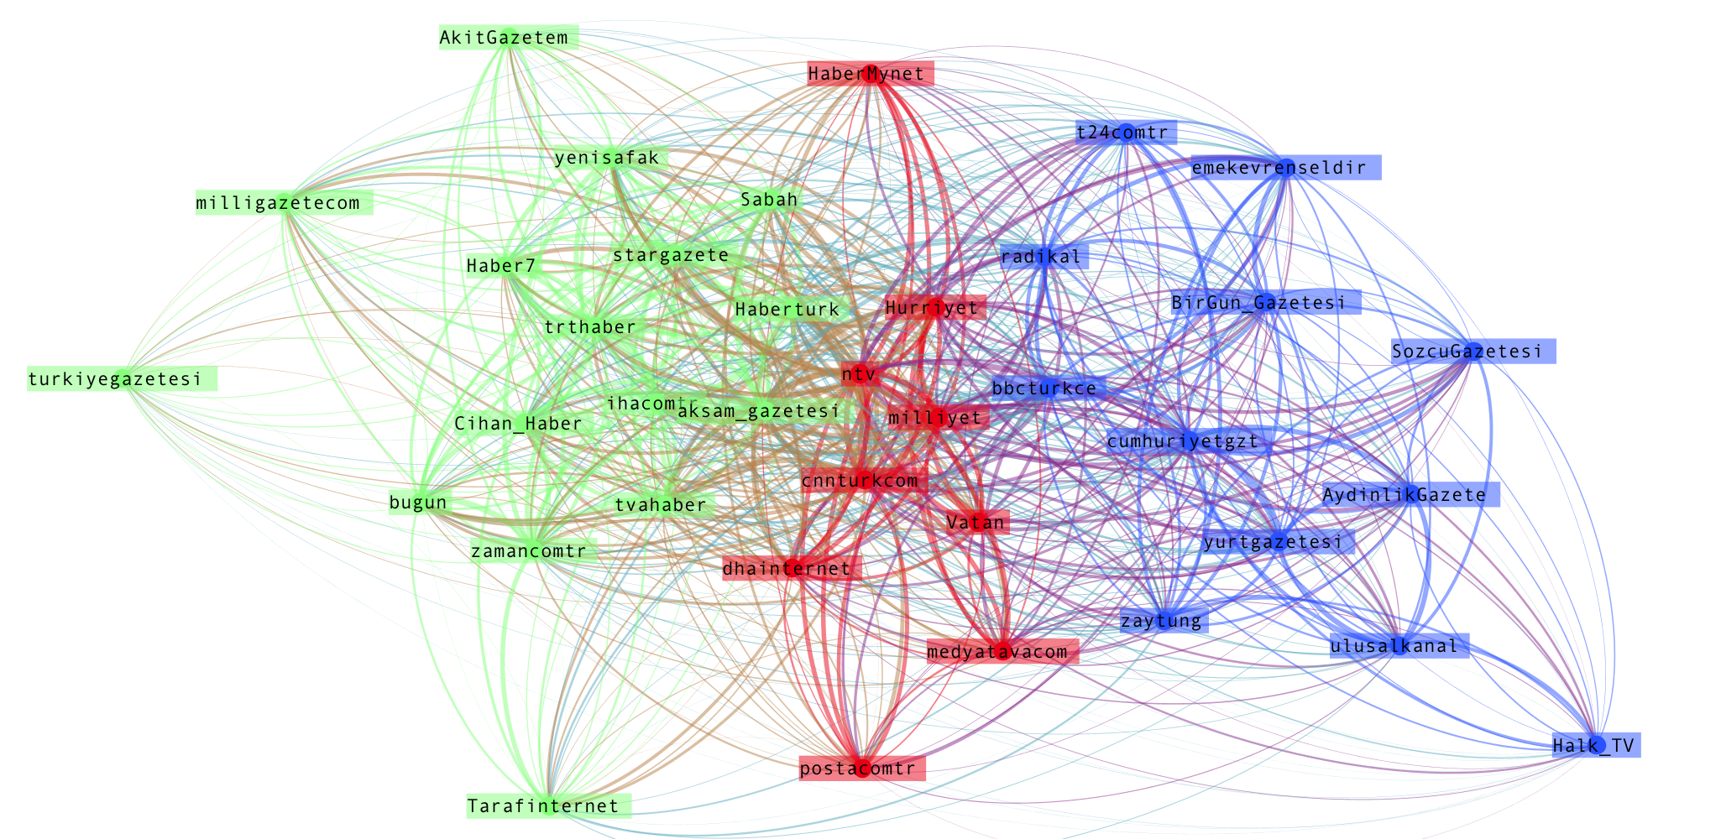
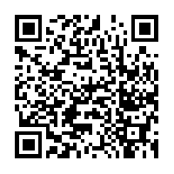
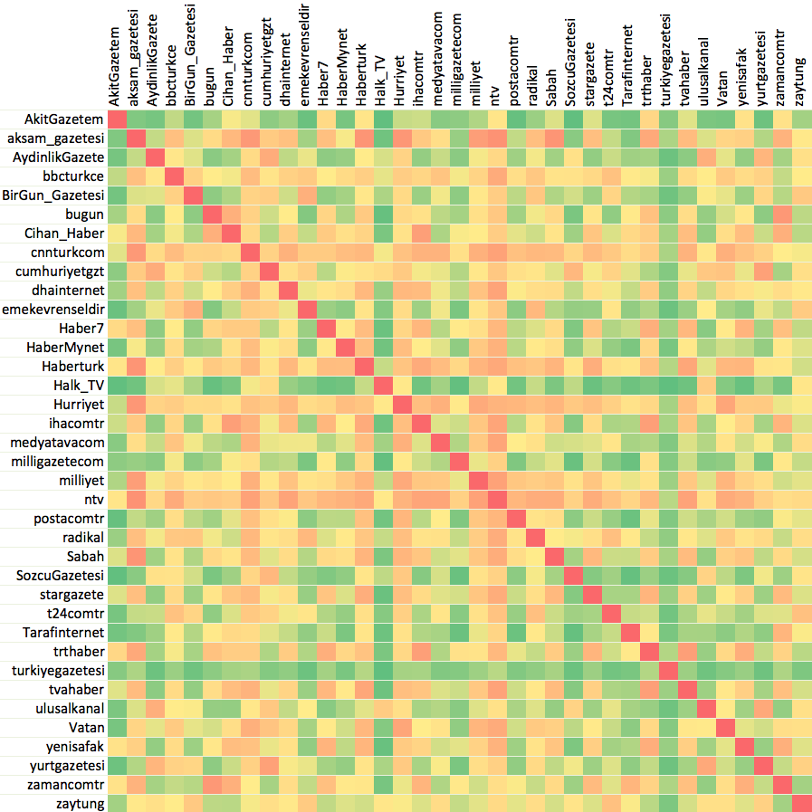
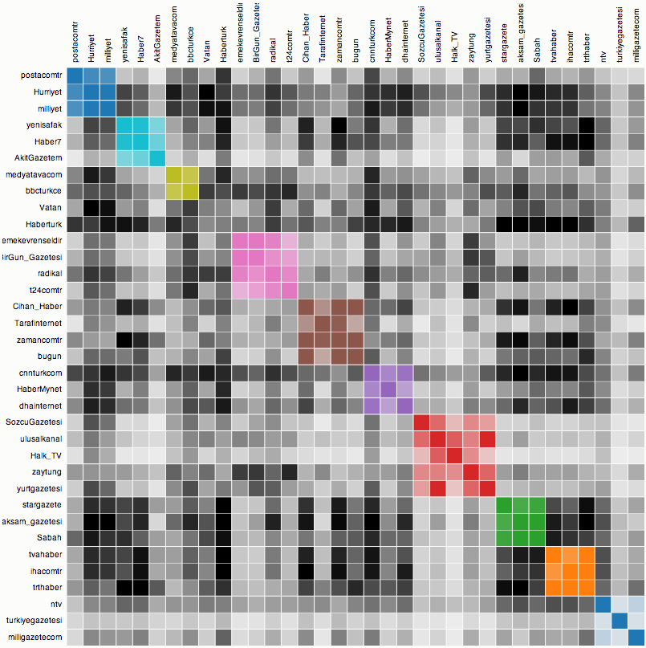
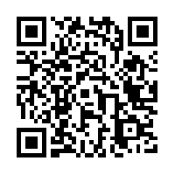
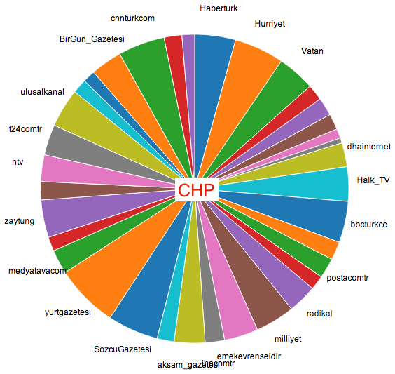
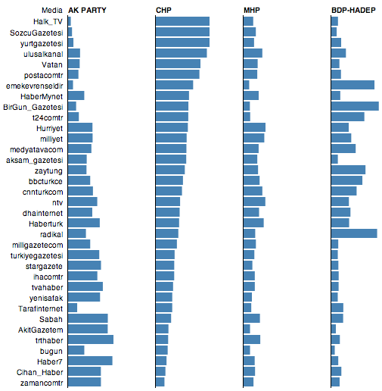
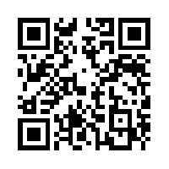
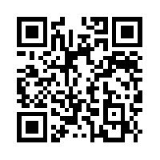
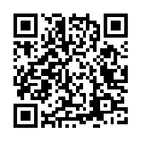

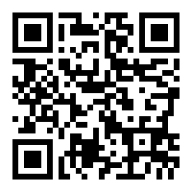
Turkish News Audience and Their Political Leanings on Twitter
Center for Discovery Science and Health Informatics
TALHA OZ, Computational Social Science
JANUSZ WOJTUSIAK, Health Administration and Policy
Abstract
The Turkish news media is believed to have a high degree of polarized pluralism and political parallelism. In this paper, the extent of this belief is computationally investigated at a large scale by collecting more than ten million Twitter user IDs. We compiled two datasets, the first being the news audience dataset which is composed of user IDs who follow at least one popular Turkish news media among thirty-seven media accounts selected. The second dataset relates to the political audience which consists of IDs following Twitter accounts of any of the four political parties in the current Turkish parliament. We first measure the pairwise similarities of news media based on their common followers and then detect the media groups at different resolutions and finally represent their relative positioning in two dimensional space. It is observed that media positioning and clusters are well aligned with the known ideologies of the media groups. We then measure the polarity of the news audiences’ political leanings and also investigate the news media preference of the party followers. Through such analysis we show that the media preferences of parties are quite different from one another and party descriptiveness of the media is almost completely reverse ordered for the parties in the opposite camps. Finally, to highlight these findings interactive visualizations are also created to make findings easier to interpret by a broader audience.
METHODOLOGY
Pairwise similarities of news media is calculated based on their common followers. Since, number of followers of the media has high variance in our dataset, we choose meet/min coefficient (Goldberg and Roth 2003) as our similarity metric over more popular Jaccard index. Let A and B be the set of follower IDs of two news media, then meet/min similarity of A to B is calculated by
Note that
A weighted complete graph K₃₇ is generated where its vertices are the 37 news media and edge weights are the meet/min similarities of their endpoints. Then a modularity based method (Blondel et al. 2008) implemented in Gephi (Bastian, Heymann and Jacomy 2009) with different resolutions is employed to detect the clusters in this generated graph. In networks, quality of a partition is usually defined by
modularity, which for weighted graphs is defined as where A_{ij} is edge
weight, is node strength, and is the total edge weight in the network.
Simply, modularity quality is
To understand the media groupings better, we investigated the clusters at various scales.
Similarly, we picked several official popular Twitter accounts from each political party currently in the Turkish parliament and collected their follower IDs. We calculated media preference of each party for each media as well as at media groups level. Findings are presented by interactive pie charts where each slice indicates the proportion of the audience of that particular media to all media readership.
We also calculated the party descriptiveness of the media, i.e. a reader’s likelihood of following a certain party. Media descriptive index is visualized with an interactive bar graph where users can sort the media by their descriptiveness for each party.
Multidimensional scaling (MDS) represents the objects geometrically whose pairwise (dis)similarity measures are given. Positions of the newspapers are obtained by SMACOF (Scaling by majorizing a convex function) algorithm for metric MDS introduced by (De Leeuw and Heiser 1980) and implemented in Python’s scikit-learn module (Pedregosa et al. 2011).
INTRODUCTION
Twitter usage for obtaining news
About half of the U.S. adults using Twitter consume news on Twitter (Pew Research Center 2013)
27% do so by following news organizations (Mitchell, Rosenstiel and Christian 2012)
In this study we exploit this public-news media following relationship.
Turkish news media
Have a high degree of polarized pluralism and political parallelism (Kaya and Çakmur 2010)
Political alignments are listed on Wikipedia (http://en.wikipedia.org/wiki/List_of_newspapers_in_Turkey)
Ownerships and other investments of media groups are studied (Kurban and Sozeri, 2012)
All major private television and radio stations, newspapers and periodicals belong to only eight media groups in Turkey (Elmas and Kurban, 2011)
Interactive data visualizations
Make the data more meaningful, easier to interpret and help explore the research outcome
Accessibility by all modern browsers (including mobile) makes JavaScript a great tool for communicating the findings
We build several interactive visualizations using D3, a JavaScript library for data visualization, and we present our findings on our website (http://www.mli.gmu.edu/toz/readership/).
RELATED WORK
Selective exposure - based on the theory of cognitive dissonance (Festinger 1962)
individuals favor their news source agreeing with their pre-existing opinions
theory holds true for shared news articles consumption on Facebook (An et al. 2013)
(Bozdag et al. 2013) question information diversity on Twitter by answering if the individuals who follow major news sources are also exposed to minority viewpoints
We examine exposure to news media sources on Twitter and their political preference
Political orientation of Twitter users
predicted by exploiting tweet text, tweet entities as well as the network information of tweeps (Conover et al. 2011; Cohen and Ruths 2013)
we simply consider an individual leaned to a certain political party if he is following one of the twitter accounts of parties in the parliament. Our main goal is to understand the political polarity of the Turkish news media by looking at the political leaning distribution of their followers
Follower counts of Turkish news media
Similarity distribution of Turkish news media
Network drawn by Gephi with Force Atlas 2 layout outperform the images generated by MDS or PCA approaches.
To see the images produced by MDS & PCA, please scan this QR code:
Scan the QR code above to see the clusters of other sizes
You can scan this QR code to access the interactive version of this similarity matrix where the cluster view and the similarity view capture invaluable information.
In this matrix, similarity increases as the color turns from green to red.
References
An, Quercia and Crowcroft 2013. Fragmented Social Media: A Look into Selective Exposure to Political News. Proceedings of the 22nd international conference on World Wide Web companion, 51-52
Bastian, Heymann and Jacomy 2009. Gephi: An Open Source Software for Exploring and Manipulating Networks. International AAAI Conference on Weblogs and Social Media
Blondel 2008. Fast unfolding of communities in large networks. Physics and Society (physics.soc-ph) J. Stat. Mech. (2008) P10008
Bozdag, Gao, Warnier, Houben 2013. Analyzing Viewpoint Diversity in Twitter. Designing Social Media for Change Workshop at CHI 2013
Conover, Goncalves, Ratkiewicz, Flammini, Menczer 2011. Predicting the Political Alignment of Twitter Users. Privacy, Security, Risk and Trust (PASSAT), IEEE Third International Conference on Social Computing (SocialCom)
De Leeuw and Heiser 1980. Multidimensional scaling with restrictions on the configuration. Multivariate analysis 5, 501-522
Festinger, 1962. A theory of cognitive dissonance (Vol. 2). Stanford university press.
Goldberg, Debra S., and Frederick P. Roth, 2003, Assessing Experimentally Derived Interactions in a Small World. Proceedings of the National Academy of Sciences 100(8): 4372–4376.
Kaya and Çakmur 2010. Politics and the Mass Media in Turkey. Turkish Studies. 11: 4, 521-537
Kurban and Sozeri 2012. Caught in the Wheels of Power: The Political, Legal and Economic Constraints on Independent Media and Freedom of the Press in Turkey. Turkish Economic and Social Studies Foundation. Democratization Program. Media studies series – 3
Mitchell, Rosenstiel and Christian, The State of the News Media 2012. At http://stateofthemedia.org/print-chapter/?print_id=11554
This pie chart lets us see the diversity of the news channels that party followers are exposed to. To see the the other parties’ pie charts, please scan the QR code on the right.
Descriptiveness of Turkish media is visualized by the bars above.
Bar length of media y for party x = (similarity of party x to media y) / (sum of all party similarities to y)
Machine Learning and Inference Laboratory
College of Health and Human Services
www.mli.gmu.edu
4400 University Dr. MSN 1J3
Fairfax, VA 22030 USA

